Slide 1


Automatic IDENTIFICATION OF RELATED LANGUAGES

Slide 2
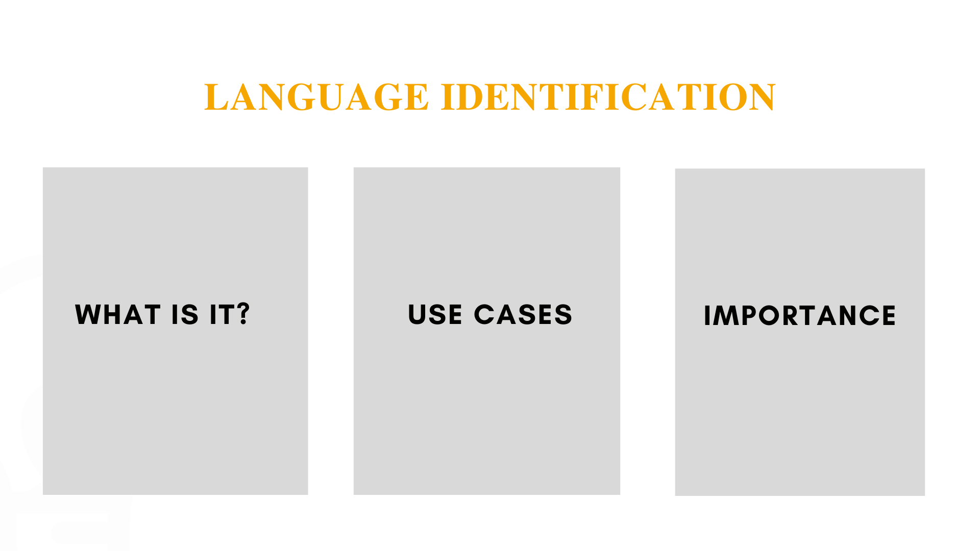

Slide 3
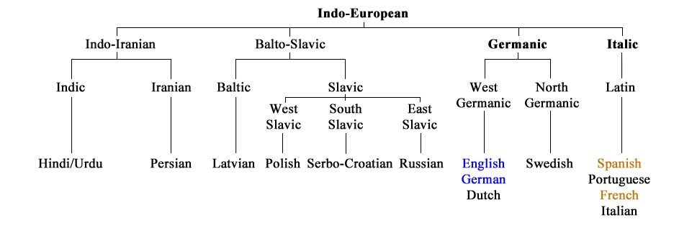
Related LANGUAGES
Indo-European Family Tree

Slide 4
DATA
Multilingual Amazon Reviews Corpus
Additional Test Samples
short 3-word sample 3-word sample from Amazon Corpus
m Amazon Corpus
European Parliament Proceedings Parallel Corpus – formal text
3-word formal text

Slide 5
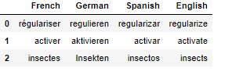
LINGUISTIC ANALYSIS
French | German | Spanish | English
é, è, à, ù, ç, â, ê, î, ô, û, ë, ï, ü, ÿ,œ,æ | ß, ö, ä | á, ñ, í, ó, ú | None
Orthography
Lexical similarity &
morphology
¡ , ¿ Spanish
„ German
Punctuation

Slide 6
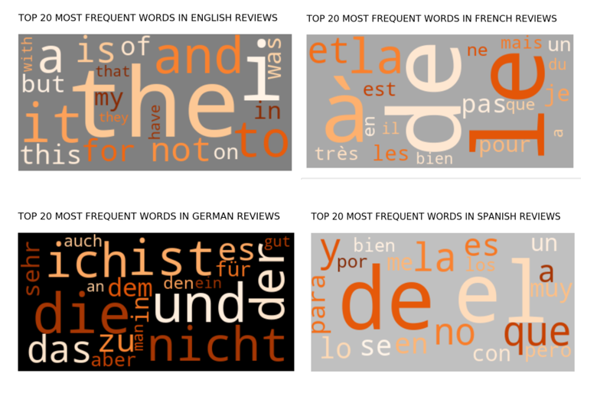
Add a Slide Title - 1
STOP WORDS
32
shared stop words

Slide 7
DIFFERENCES IN PREPROCESSING TECHNIQUES
TYPICAL OF MONOLINGUAL CLASSIFICATION
ACCOUNTING FOR LINGUISTIC NUANCES
Removing punctuation
Removing stop words for each of the languages
Stemming
Keeping ¡ , ¿ , and „
Removing only stop words shared by the languages
Skipping stemming and lemmatization

Slide 8
Vectorization
predictor
target
statistical models
typical of monolingual classification | preserving linguistic nuances
1-3 word level n-grams in TF-IDF | customized TF-IDF with 1-3 word level n-grams
one-hot encoding
bidirectional LSTM
embeddings trained as part of the neural network

Slide 9
modeling
MULTICLASS CLASSIFICATION
Target variable language
Predictor variable review_body
METHODS AND METRICS
Cross-validation for statistical models, loss and accuracy monitoring for the train and validation set in the neural network
Accuracy – main metric

Slide 10
STATISTICAL MODELS 10,000 features
Why Multinomial Naïve Bayes?
Multiclass classification
Easy to build
Handles large datasets well
Handles a large number of features well
High performance for text classification
RANKINGS
99.964%
Multinomial Naïve Bayes
99.961%
Logistic Regression
SVM (o-v-o)
99.953%
SVM (o-v-r)
99.925% Random Forest

Slide 11
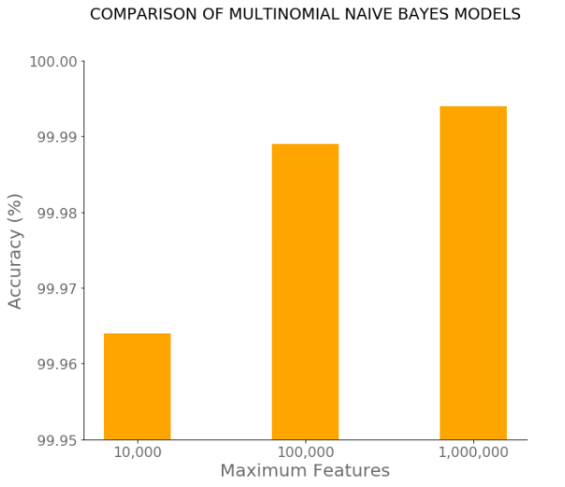
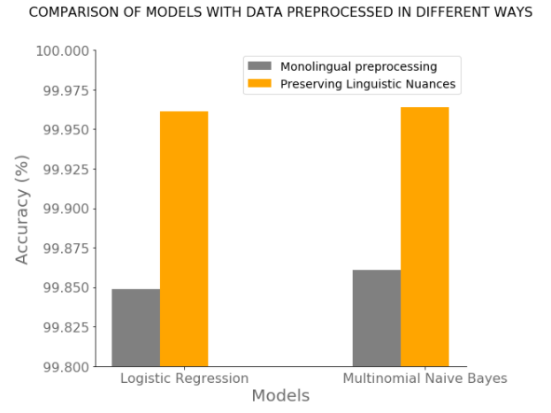
COMPARISON of CROSS-VALIDATED STATISTICAL MODELS

Slide 12
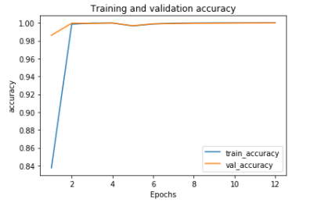
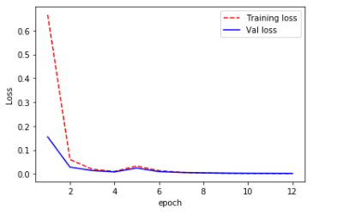
BIDIRECTIONAL LSTM
99.99%
Training and validation loss

Slide 13
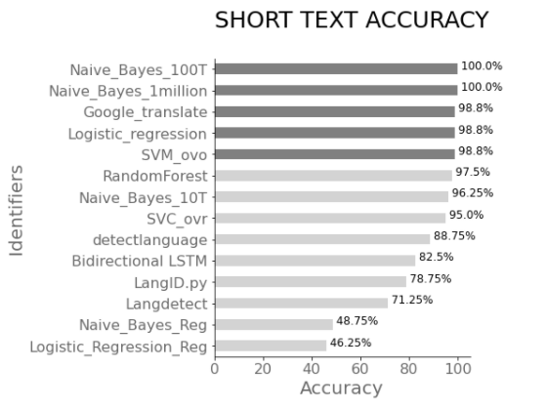
Performance on short text
Best performing models:
Multinomial Naïve Bayes with maximum features = 1 million
Multinomial Naïve Bayes with maximum features = 100,000

Slide 14
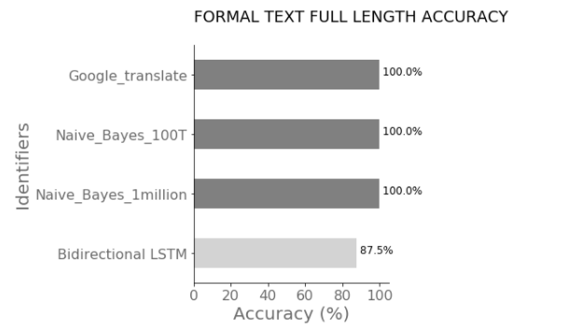
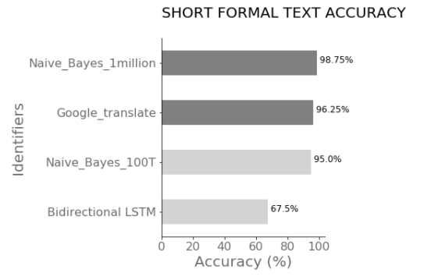
ADDITIONAL TESTING OUTSIDE OF THE DOMAIN
Best performing tool
Multinomial Naïve Bayes with maximum features = 1 million

Slide 15
RESULTS
Multinomial Naïve Bayes with the maximum features set to 1,000,000 is the best performing model with an accuracy of 99.994%
Preserving unique linguistic characteristics of each of the languages contributes to higher models’ performance
The model generalizes well outside of the domain
The model classifies well on short samples

Slide 16
LIMITATIONS AND FUTURE CONSIDERATIONS
Number of languages
The pool of languages needs to be expanded
Increase the number of
samples
Domains

Slide 17


